Slide 1
Assignment 2
Bozhidar Bozhikov, Sebastián Rojas Garcia, Fernando Alonso Chang Navarro

Slide 2
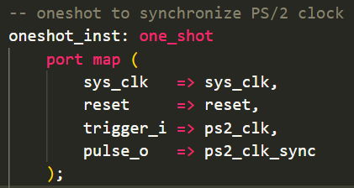
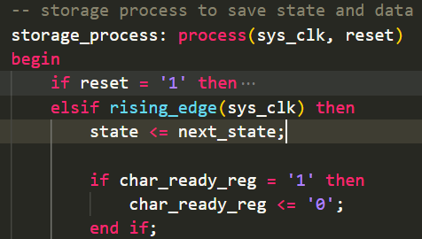
Task 1 - Keyboard Driver

Slide 3
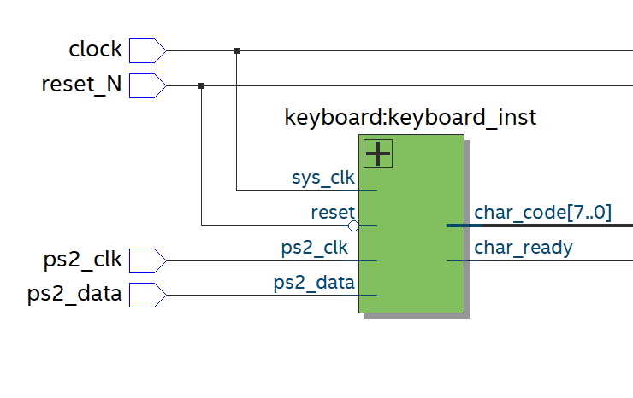
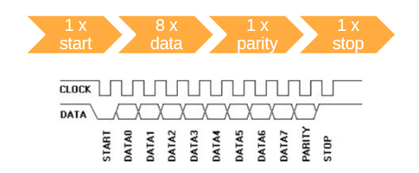
Task 1

Slide 4
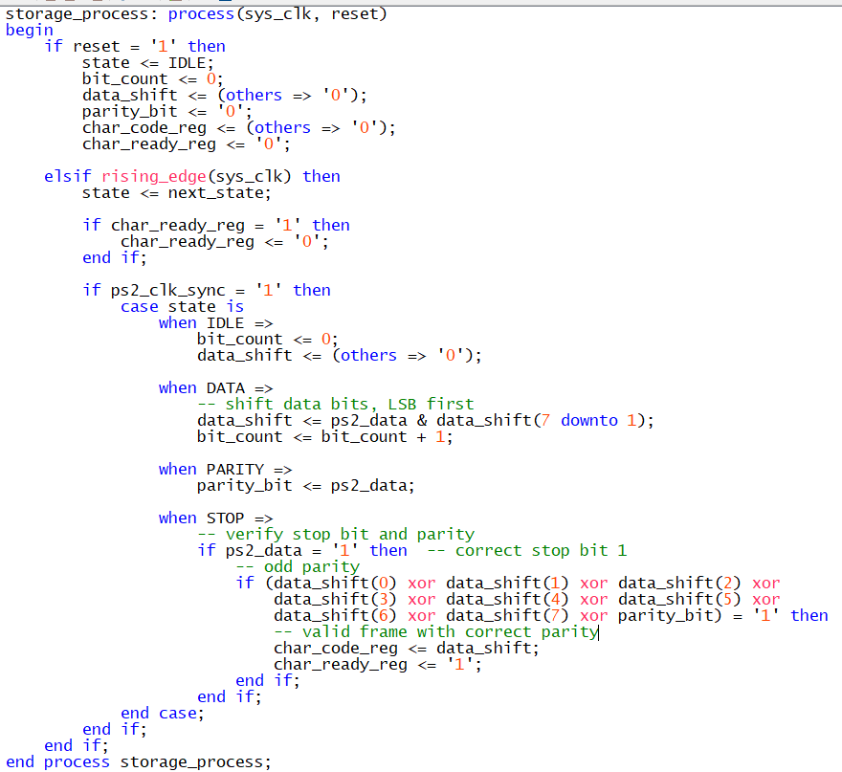
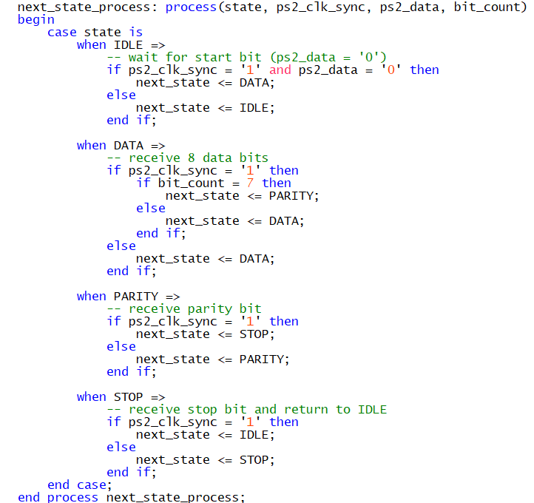
Task 1 - Keyboard Driver

Slide 5
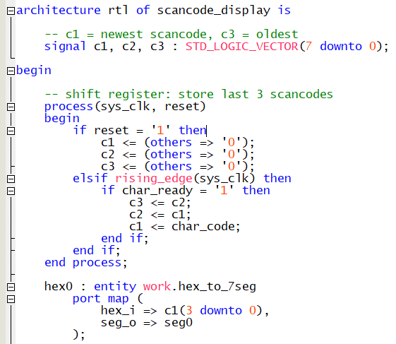
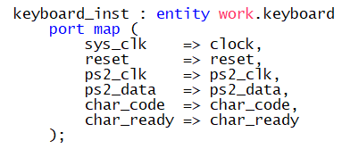
Task 2 - Test Keyboard Driver

Slide 6

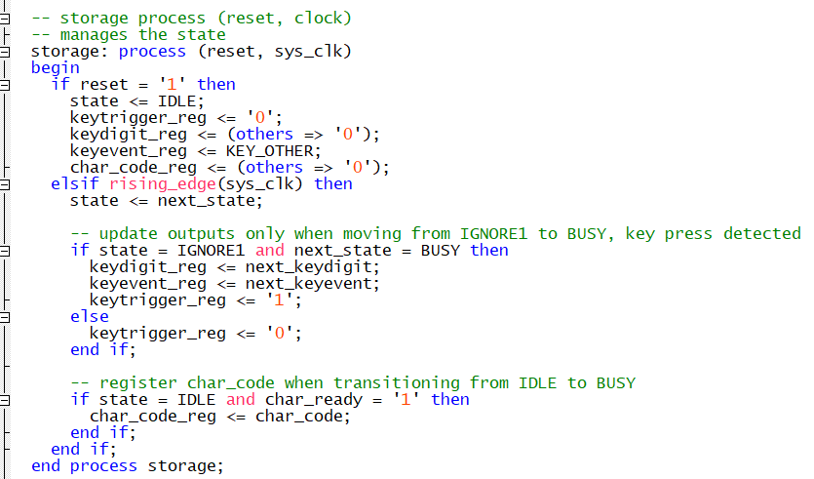
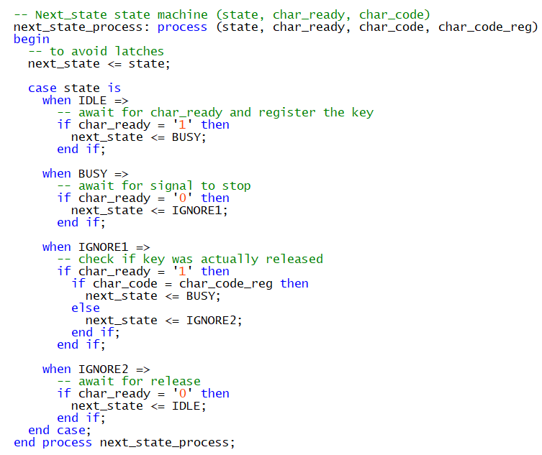
Task 3 - Scancode Decoder

Slide 7
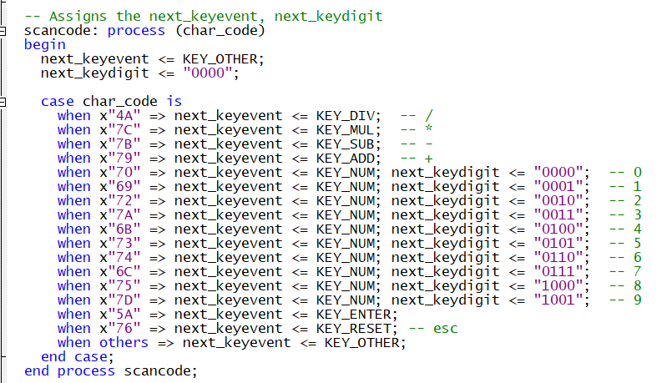
Task 3 - Scancode Decoder

Slide 8
